Slide 1
MIU Schedule online Registration System

Slide 2
Content
Introduction -State the problem scenario
Use case Model(use case description and use case diagram)
System Architecture Diagram
Key Abstractions
Sequence Diagram
Class Diagram

Slide 3
Introduction
MIU schedule will be a schedule builder application for MIU’s computer professionals program. Many years ago, scheduling of classes and faculty was done with a comparably easy excel spreadsheet since there were probably 20-40 students per three entries every year. The student registration part will be kept as a simple tool for this project. In short, there was a problem of managing compro student schedules and allowing them to register for classes. This system affects not only students, but also administrators and faculty.

Slide 4
This tool will be useful to any university that uses the block system for offering classes. With small modifications it could also be used for Semester based programs.
The Use case Diagram- shows who are the actors and what actions they can take on the system in a very abstract form.

Slide 5
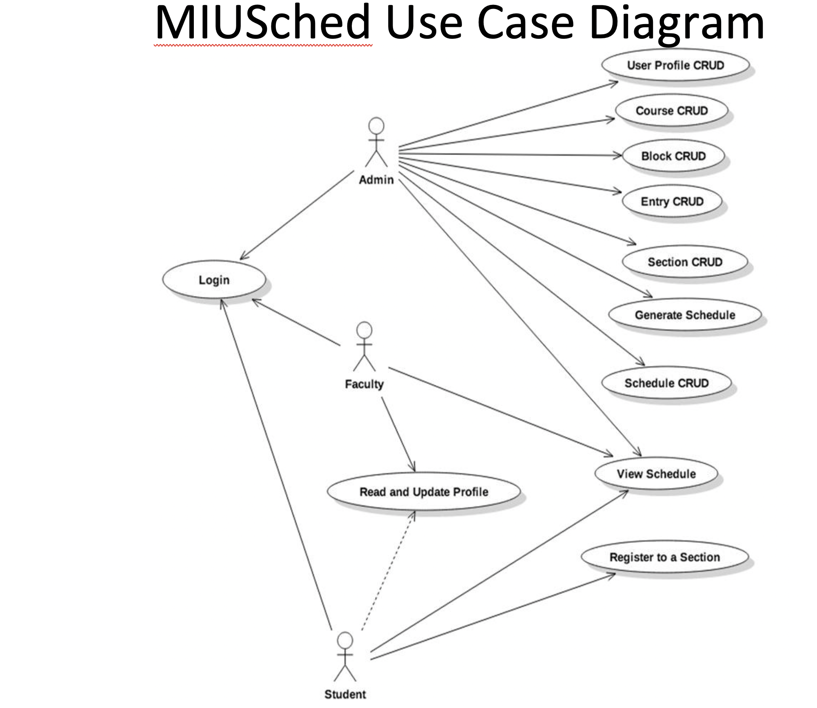
MIU Schedule Use case Diagram

Slide 6

Use case description for one of Admin actions
Admin generates a schedule
This use case allows an Administrator/s to generate a schedule for one or more entries.
Actor - Administrator
Preconditions - Admin is logged into the system and at Admin welcome page, Entry, Block, and Course will be provided.
Post condition: for the succeeded case, the new schedule will be saved to the Database with the correct status.
Business Rules:
Faculty are assigned to the blocks that they prefer.
Faculty teaches the number of block sets in their profile.
Any Faculty staffed for a section must exist
Section should be targeted for a block per target block preference in their course
Nonfunctional Requirement: none
Flow is as follow:

Slide 7
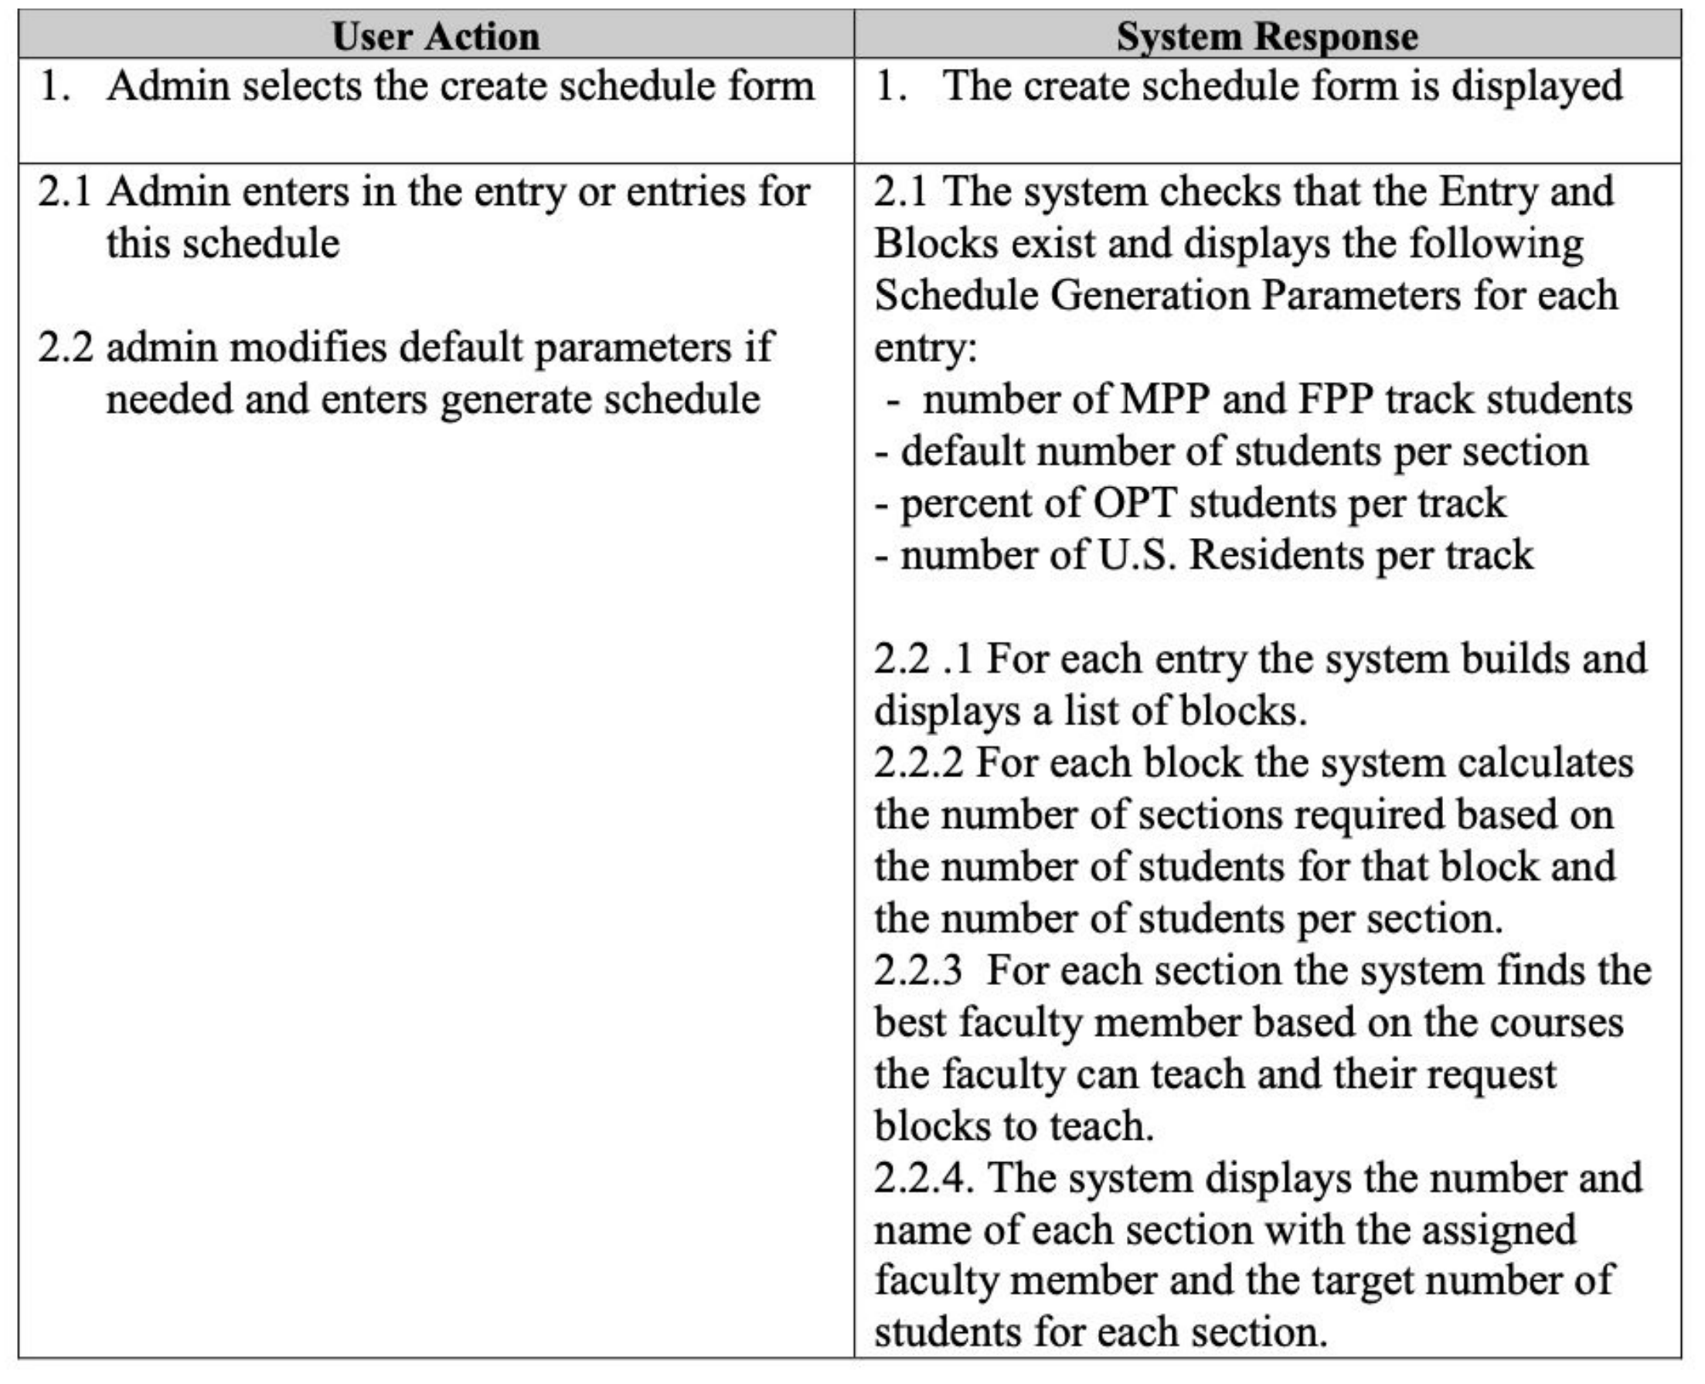

Slide 8
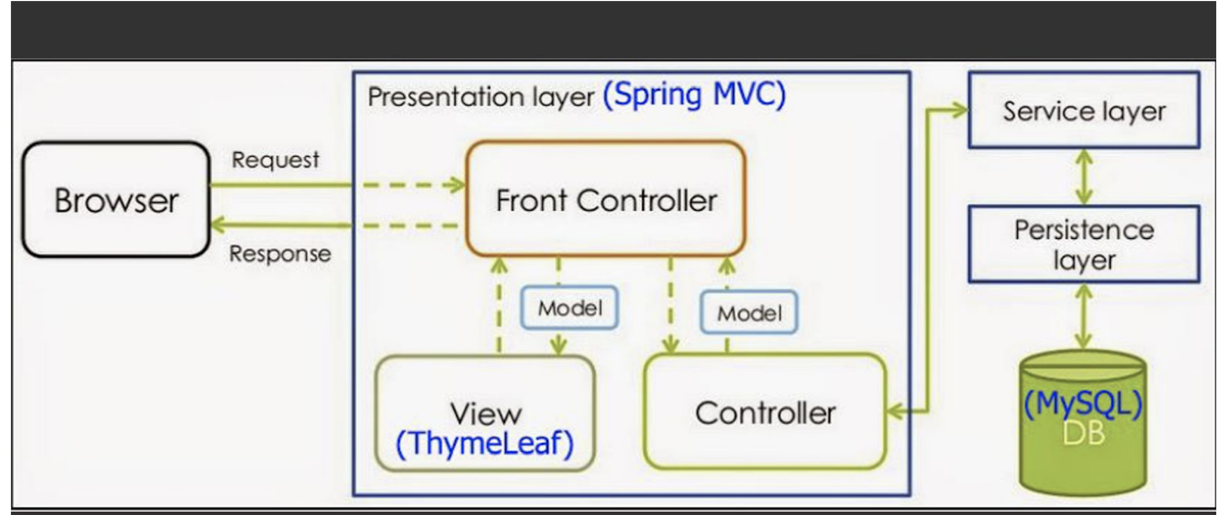
System Architecture Diagram

Slide 9
Key Abstractions
(Actors which system has internal data, external systems which require system interaction, entities that are important parts of the business operation, and any obvious attributes and operations) are the followings;
Student
Faculty
Administrator
Course
Section
Pre-requirement
Schedule
Form classes
Controller classes

Slide 10
Sequence Diagram
interaction diagrams that detail how operations are carried out. They capture the interaction between objects in the context of a collaboration.

Slide 11
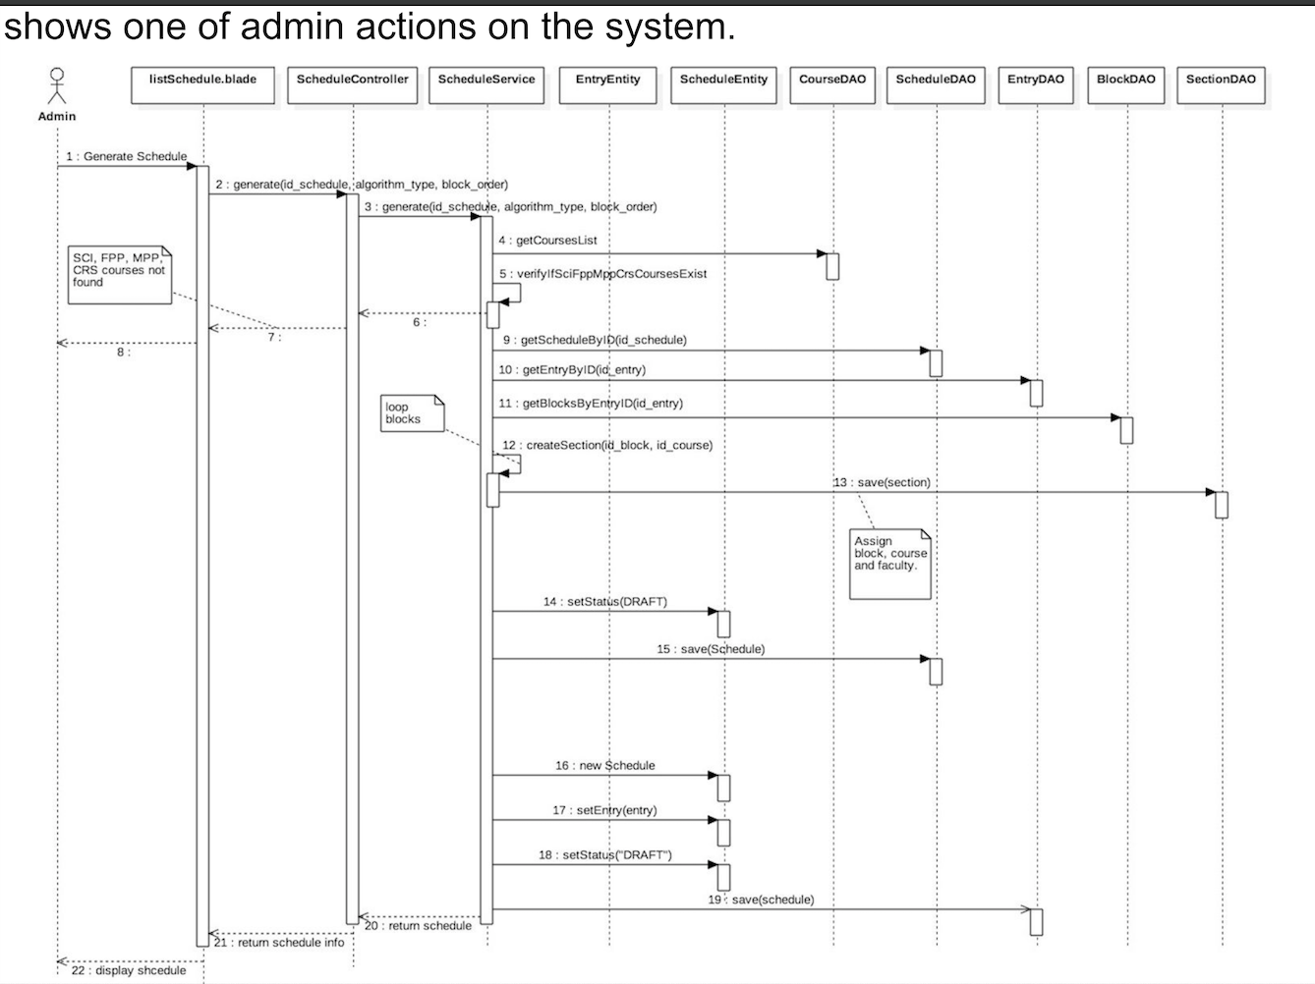

Slide 12
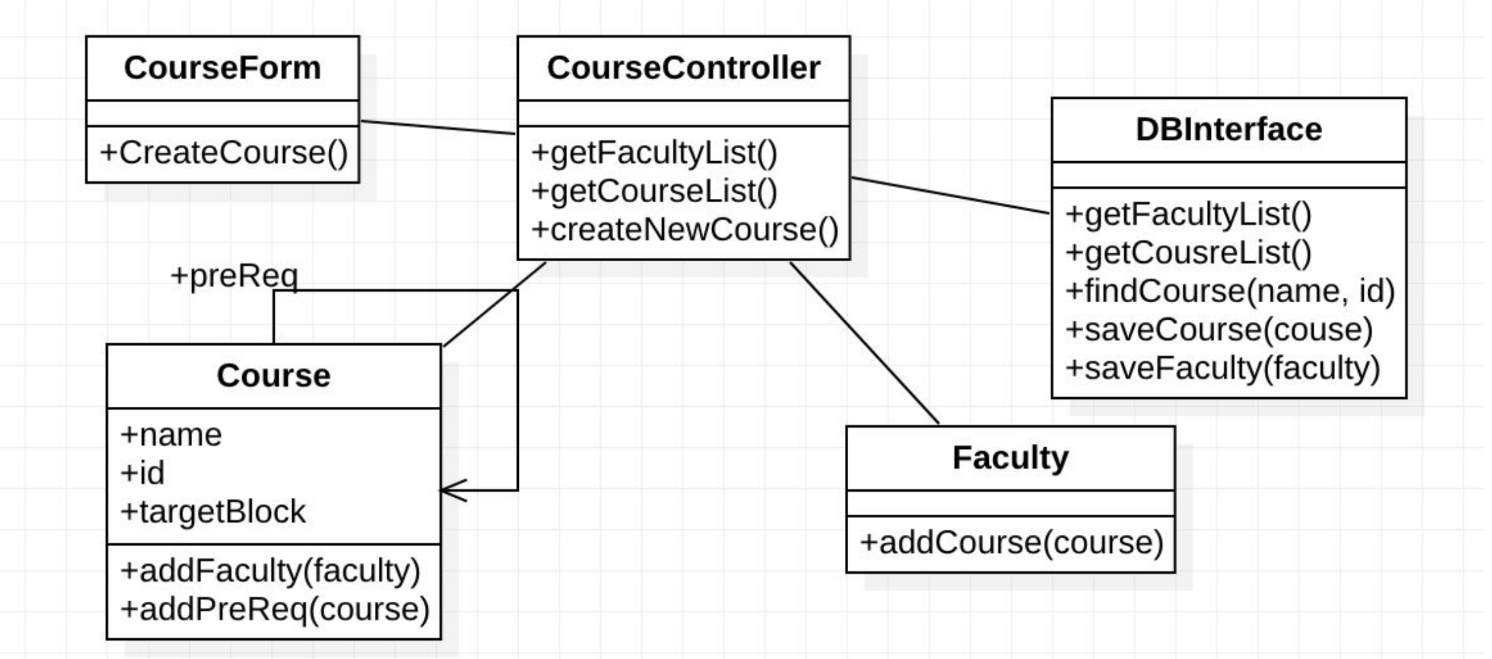
View of Participating Classes

